Slide 1
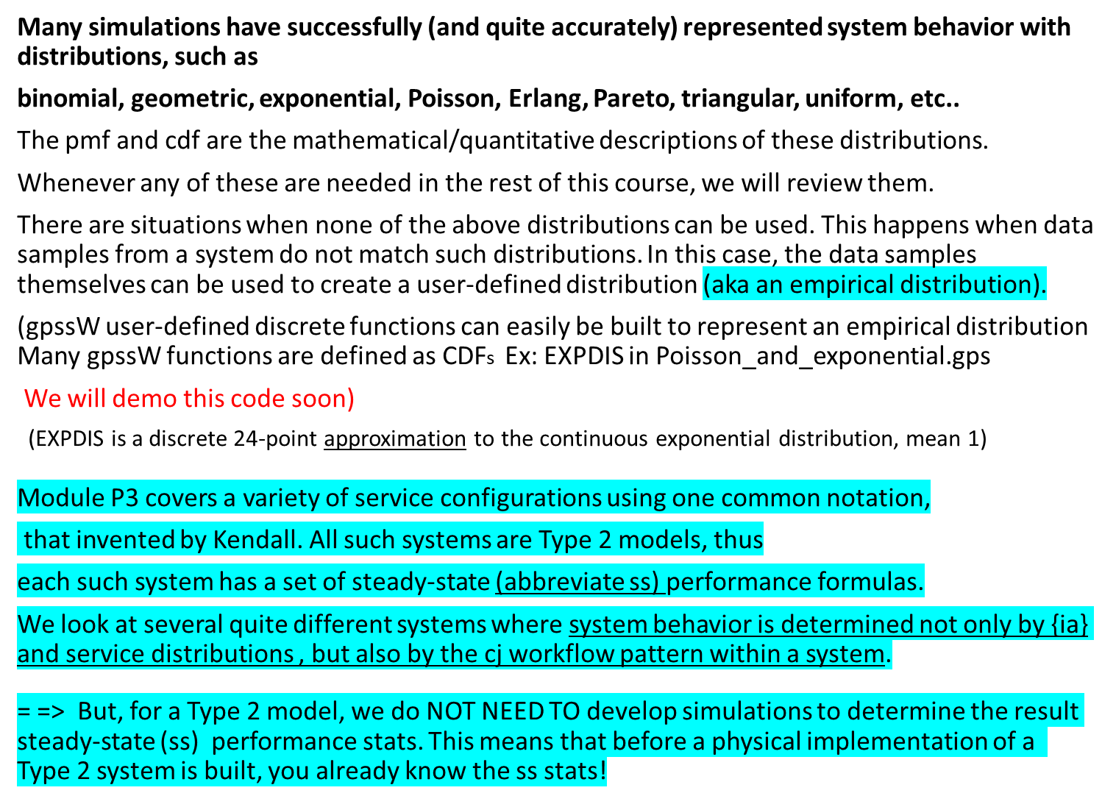
Stochastic Models

Slide 2
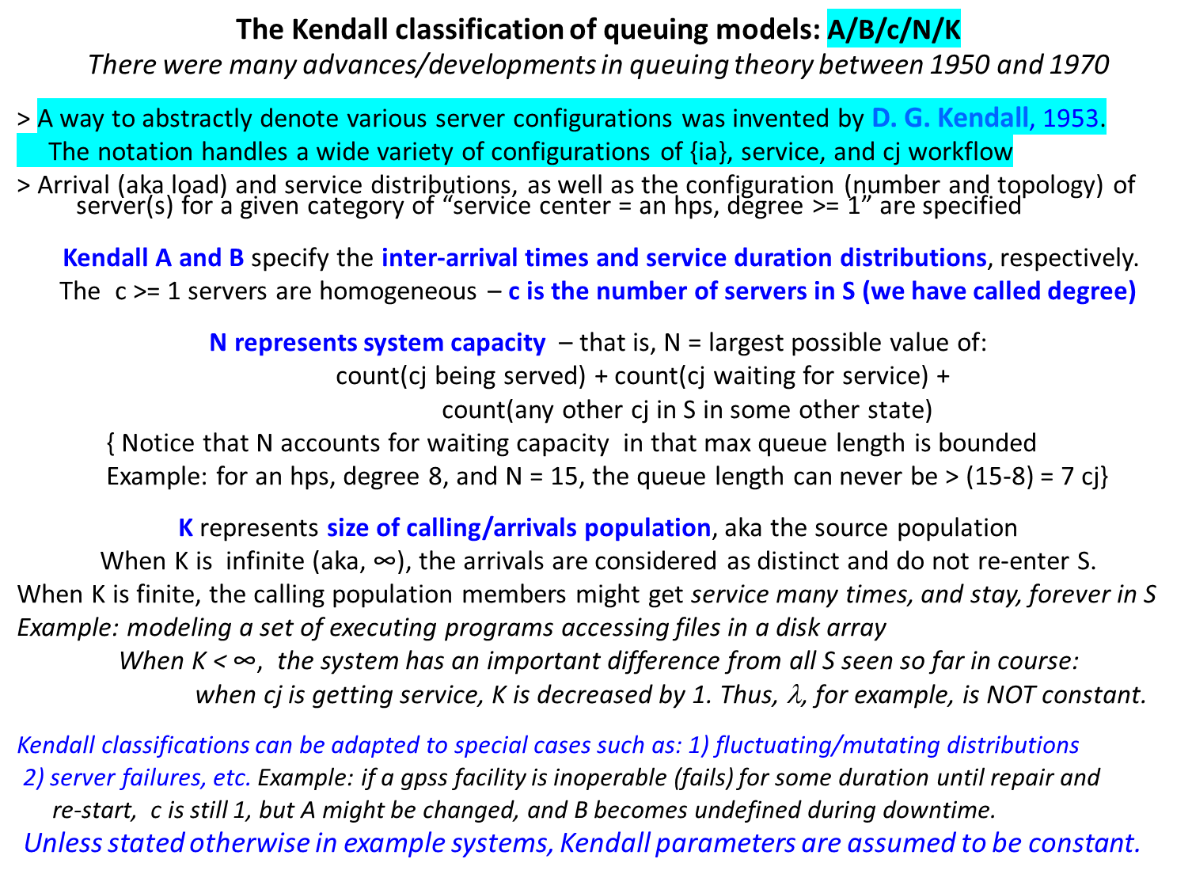
Server/service center system structure

Slide 3

Brief Kendall biblio
David George Kendall FRS^{[1]} (15 January 1918 – 23 October 2007)^{[3]}was an English statistician and mathematician, known for his work on probability, statistical shape analysis, ley lines and queueing theory. He spent most of his academic life in the University of Oxford (1946–1962) and the University of Cambridge (1962–1985). He worked with M. S. Bartlett during World War II, and visited Princeton University after the war.^{[4]}

Slide 4
The steady-state values for Kendall systems
Below is a list of parameter notations for the most common server configurations; “long-term” is often used to mean theoretical values that an observer would see if S was operated for an indefinitely long time; these values are also called Steady-State (ss) values.
An ss value is the average over arbitrarily many samples of that value.
Classification of Kendall notations, by color code:
SS (i.e., limit/long-term behavior)
System configuration parameter
Model state/statistics info
P_{n} - ss prob (there are n customers in system)
P_{n}(t) - ss prob (there are n customers in system at time t)
λ− Arrival rate
λ e - Effective arrival rate (Actual rate of arrivals; omits arrivals that leave S prematurely)
μ− Service rate of one server
μ _{e} - Effective service rate of one server
ρ - ss server utilization
A_{n} - Inter arrival time between customer (n-1) and customer n
S_{n} - Service time of nth arriving customer
W_{n} - Total time spent in system by nth customer (aka residence time)
W_{n}^{Q} - Total time spent waiting for service by nth customer
L(t) - Number of customers in system at time t ( earlier in course denoted by n(t) )
L_{Q}(t) - Number of customers in service queue at time t
L - ss average number of customers in S (aka, avg (L(t)) )
L_{Q} - ss average number of customers in queue (common queue if multiple servers)
w - ss average time spent in S (aka residence duration in S) per customer
w_{Q} - ss average time spent in queue per customer

Slide 5
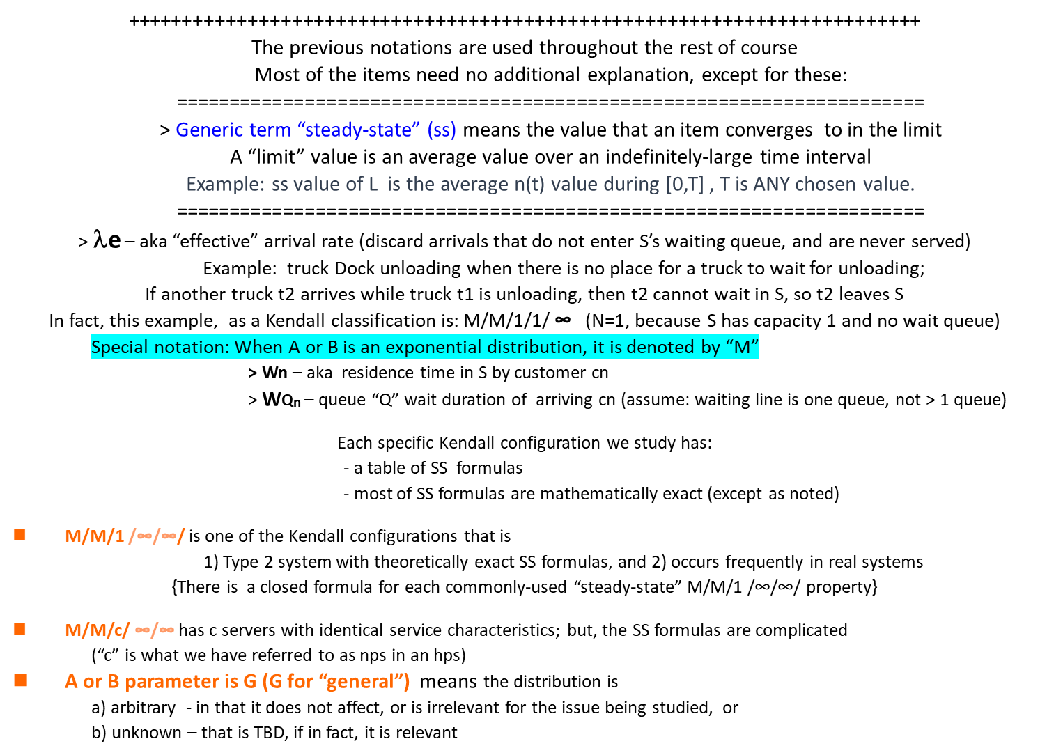
The steady-state values for Kendall systems

Slide 6
Long-run measures of performance
Everyday experience gives some insight on how well a given system is working …
* Performance measures are well-known to those who work in this subject
* Improving/correcting a performance problem in some S involves
1) applying well-known formulas for Kendall systems
2) experience + knowledge of operations details to identify specific “bottlenecks”
Before covering common Configurations, review some fundamental system measurements:
L = (average number in S) { a congestion indicator (because it quantifies queueing) } and
w = { average residence time) { the most direct measure of efficiency experienced by a customer }
= server utilization is almost always a good predictor of service performance
Kendall classification is flexible enough to include other service paradigms not covered so far –
Example1: cj can “recycle”, means cj can optionally get >1 service from the server
- - > cj arrives - - > enter queue - --> cj starts service - - > cj finishes service - - > other actions - - -> Leave S: (prob p)
Stay in S: prob (1-p)
Example2: each arriving cj never needs to wait = > models “infinitely” many servers;
In other words, each arriving cj can be immediately assigned to service

Slide 7
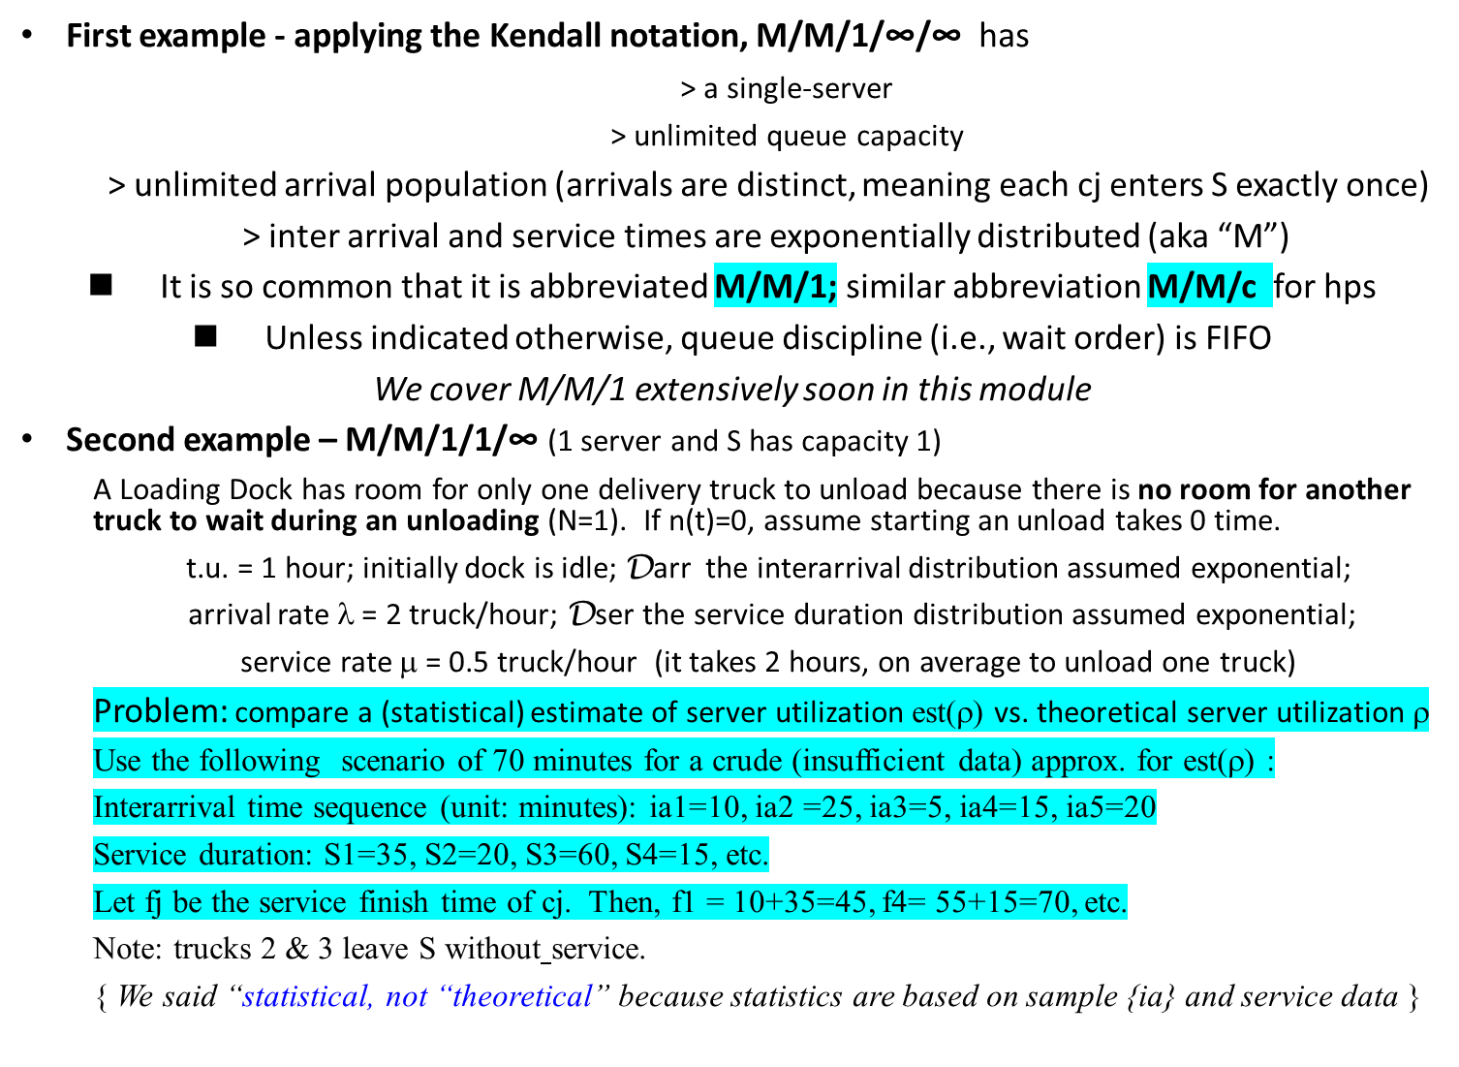
First look at 2 common Kendall Models – M/M/1 and M/M/1/1/∞

Slide 8
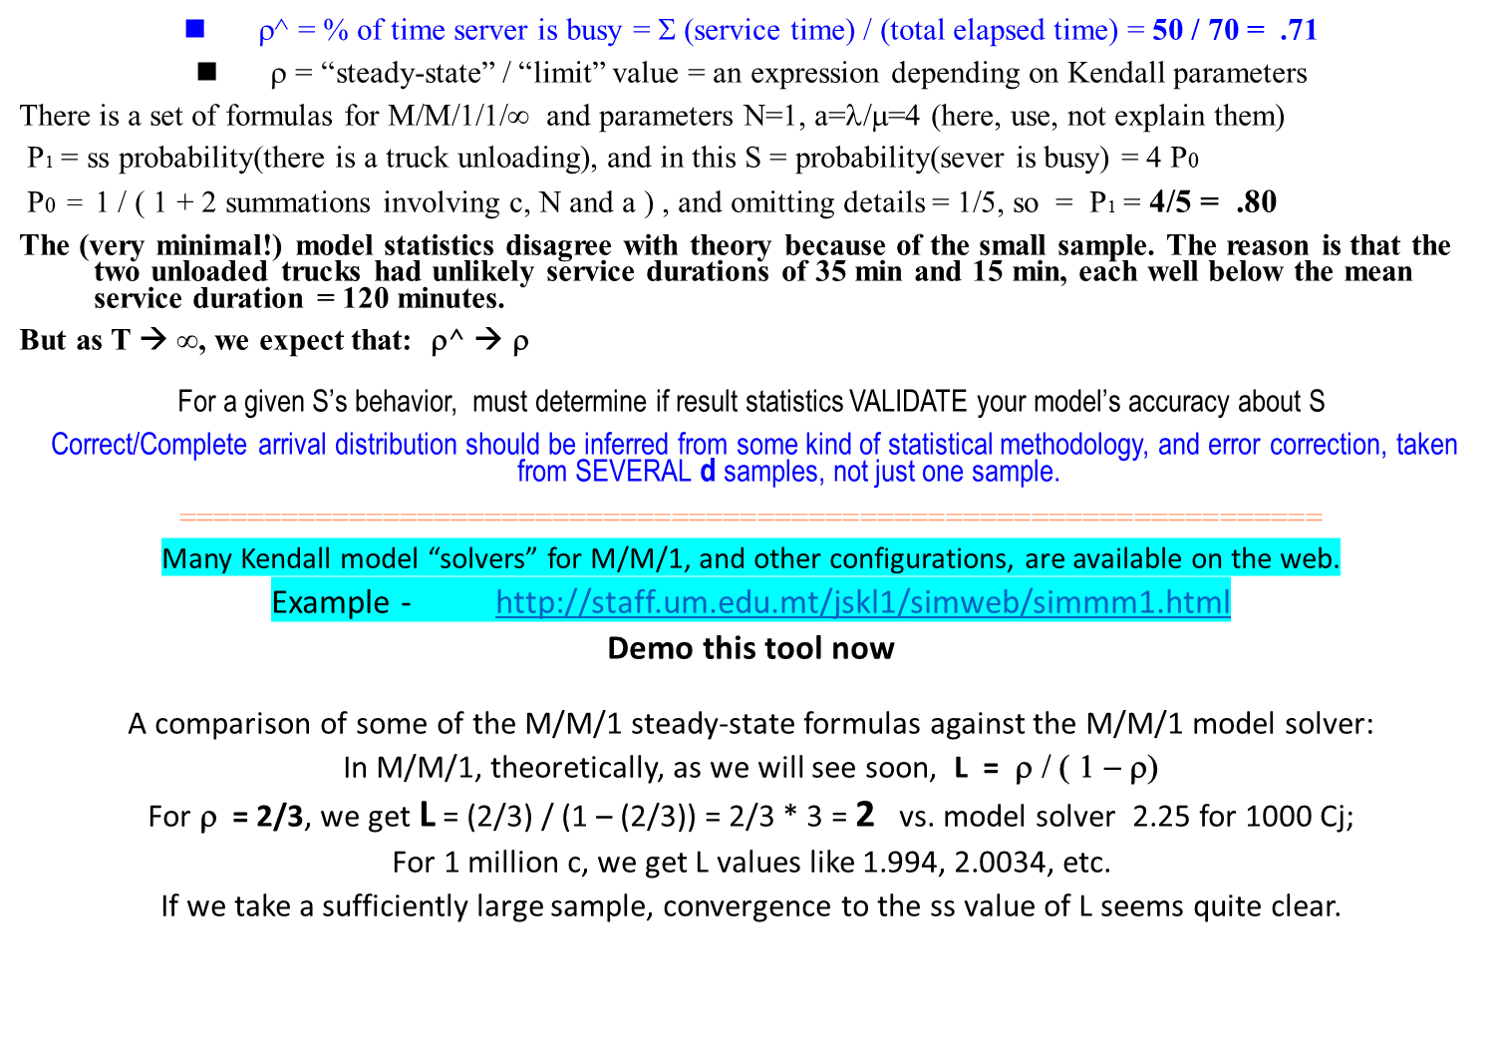
Example M/M/1/1/∞ , abbreviated as M/M/1/1

Slide 9
M/M/1 steady-state (ss) statistics – 1 of 2
SUMMARY of Assumptions and Properties for M/M/1 systems
1. Interarrivals and service durations are highly variable
Arrivals are assumed separated in time so that simultaneous arrivals are not allowed
(Physical constraints/limitations in many real systems justify this assumption)
2. Because there is only one server, and each (service duration) is > 0, by the same
modeling rationale as in 1., simultaneous service finishes do not happen
3. In all Kendall systems in this course, so far, that a server is:
* 100% reliable (never fails), and
* non-preemptive (once a service starts, it is never interrupted)
( gpssW is well-capable of modeling service interrupts (any hardware/software kinds),
but we cover preemptive/interruptible service later using the simpy DES environment )
M/M/1 ss formulas
Formula description | Expression
ρ | λ / μ (already proved this )
Pn = Prob(there are n cj in S) | ρ ^{n} * ( 1 - ρ )
P0 = Prob(there are no cj in S) = idle S <= Special case of Pn | ( 1 - ρ )
L = avg(number of cj in S) | ρ / ( 1 - ρ ) = λ / ( μ − λ )
LQ = avg(number of cj in queue) | ρ ² / ( 1 - ρ )
W = avg(cj residence duration in S) | 1 / ( μ ∗ ( 1 − ρ ) )
WQ = avg(cj residence duration in queue) | ρ / ( μ ∗ ( 1 − ρ ) )

Slide 10
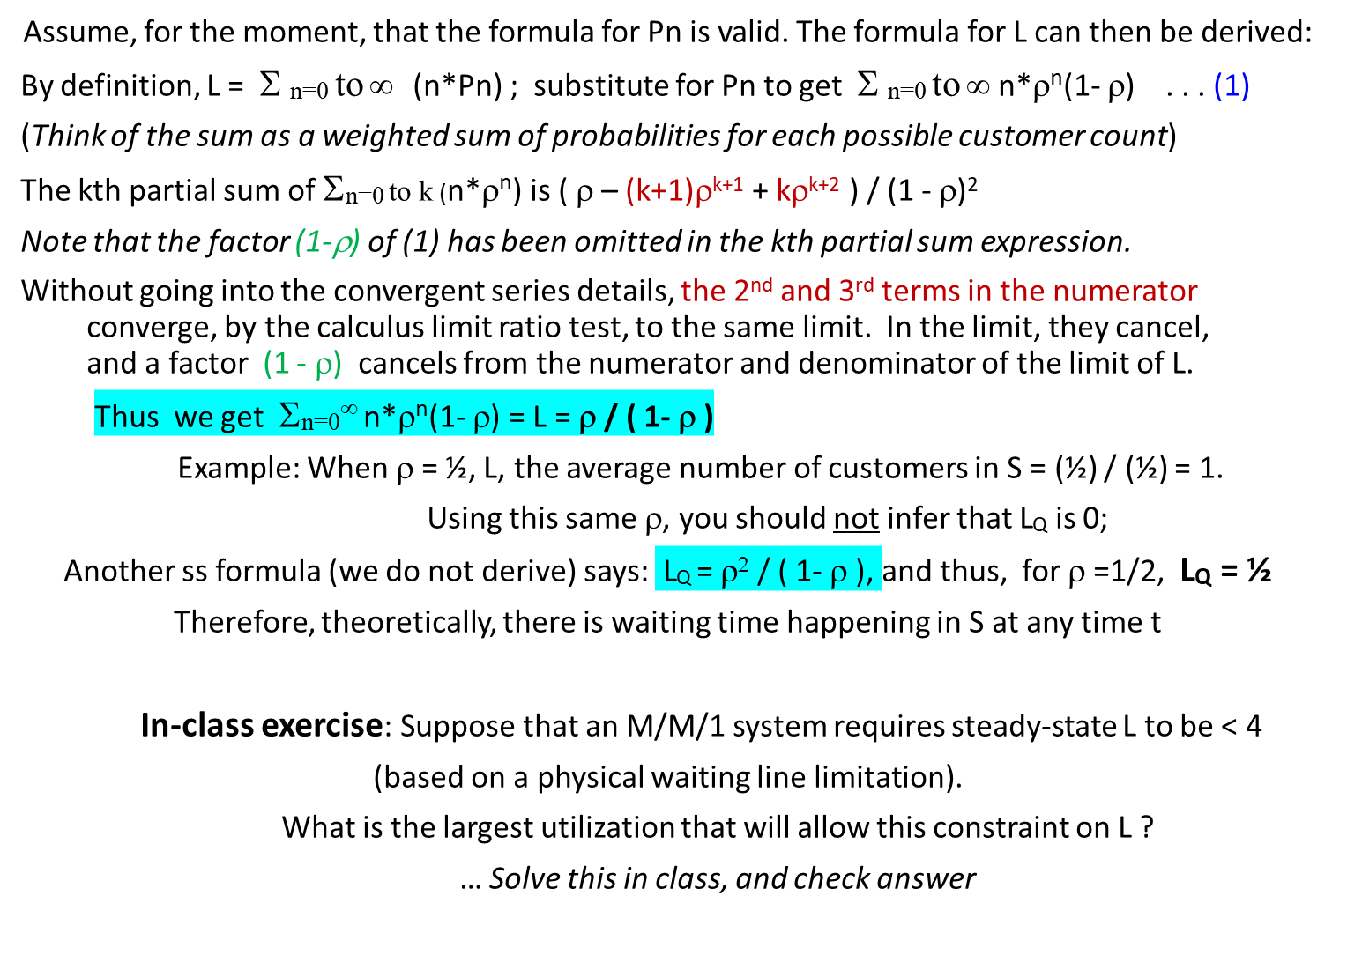
M/M/1 steady-state (ss) statistics - 2 of 2

Slide 11
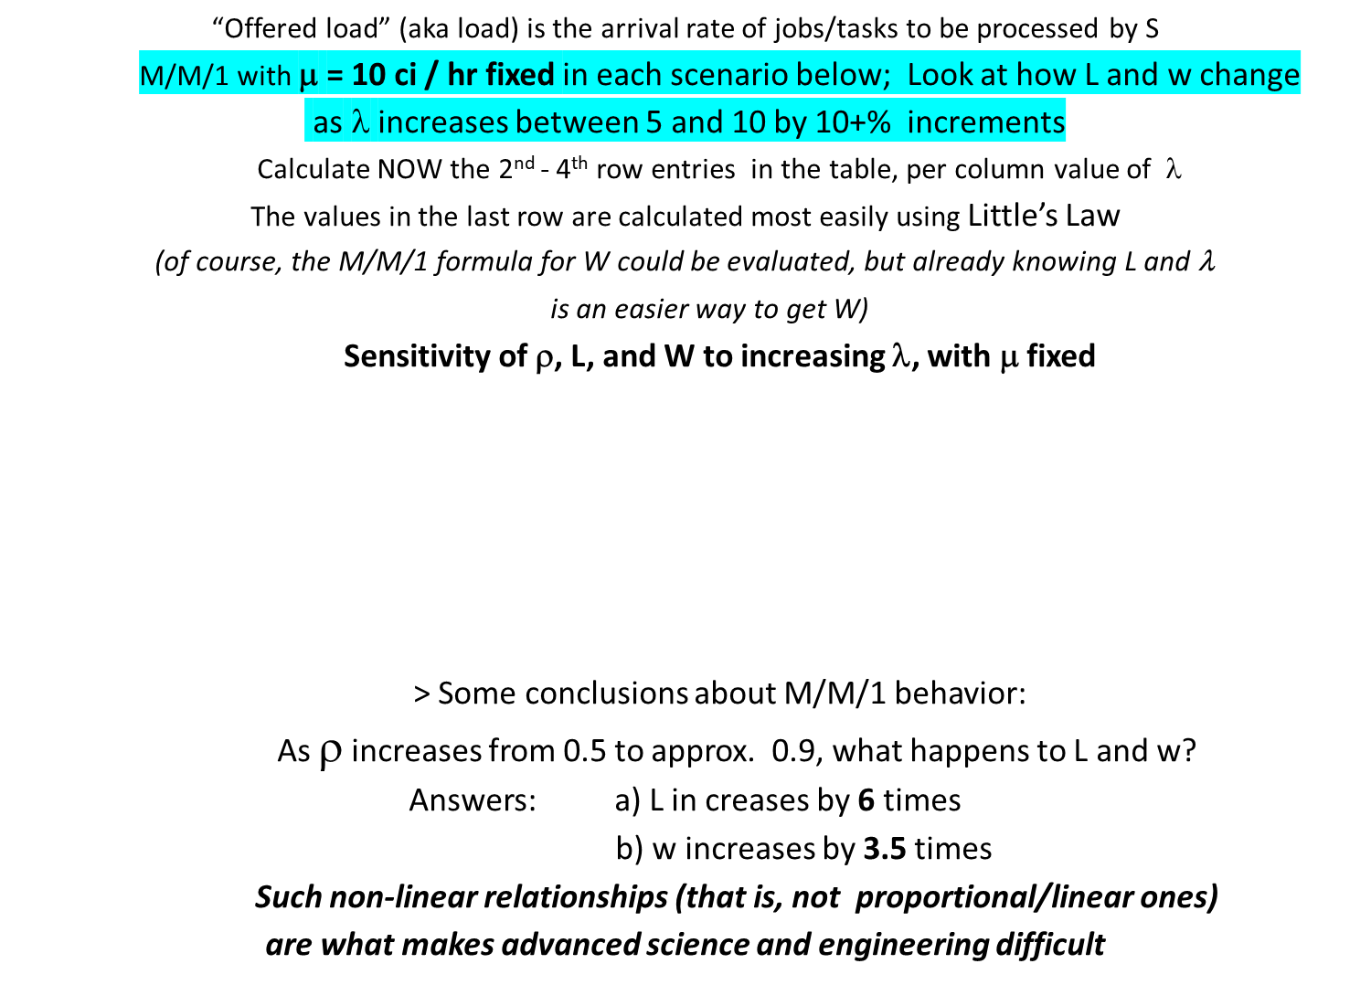
M/M/1 load relationships
λ | 5.0 | 6.0 | 7.2 | 8.64 | 10.0
ρ (%) | 50 | 60 | 72 | 86.4 | 100
L | 1.0 | 1.5 | 2.57 | 6.35 | -- >∞
W = L/λ | 0.2 | 0.25 | 0.36 | 0.73 | -- >∞

Slide 12
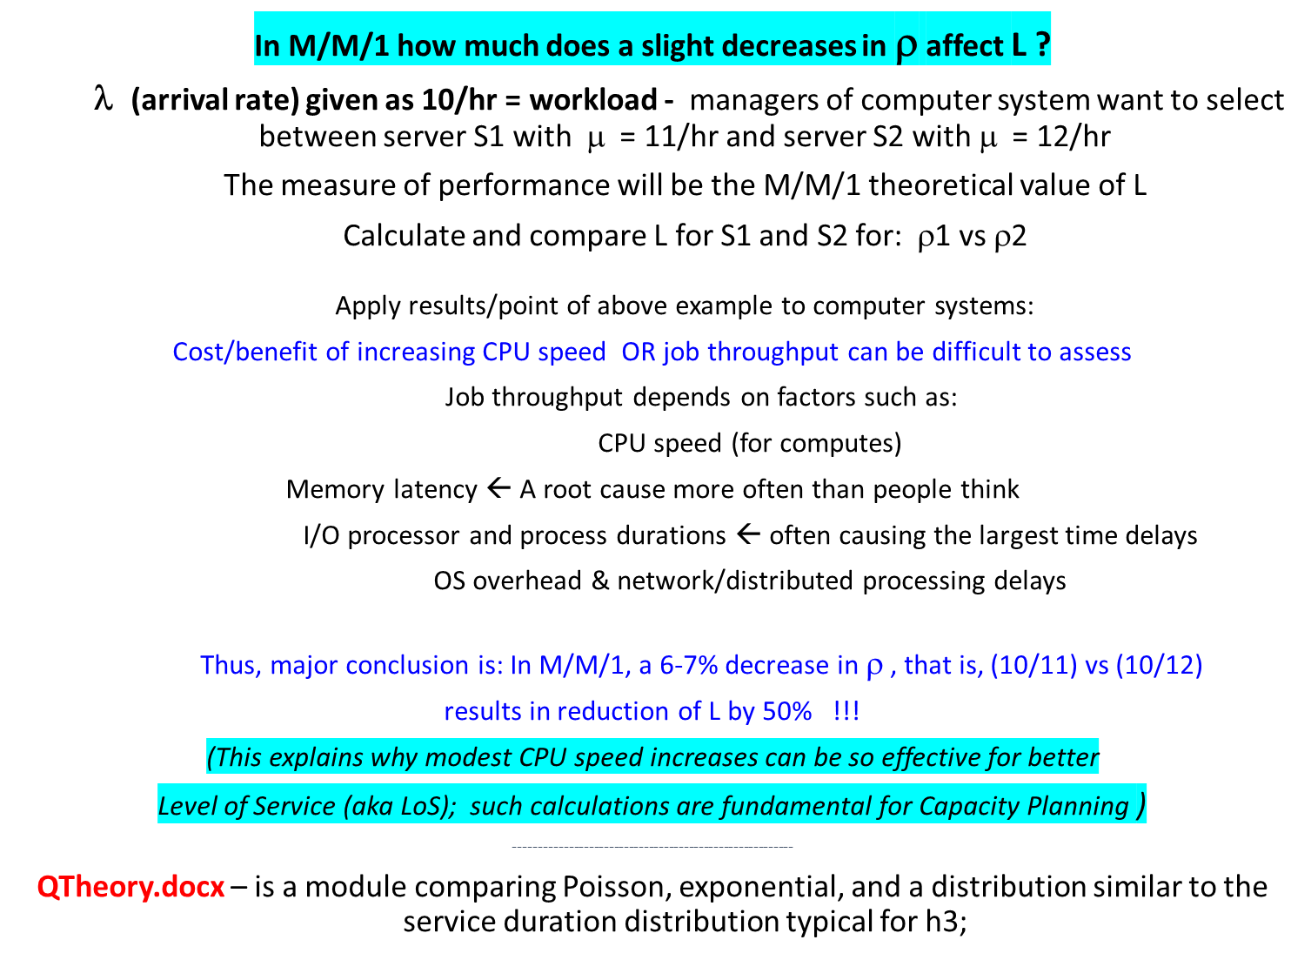
Applications to Capacity planning

Slide 13
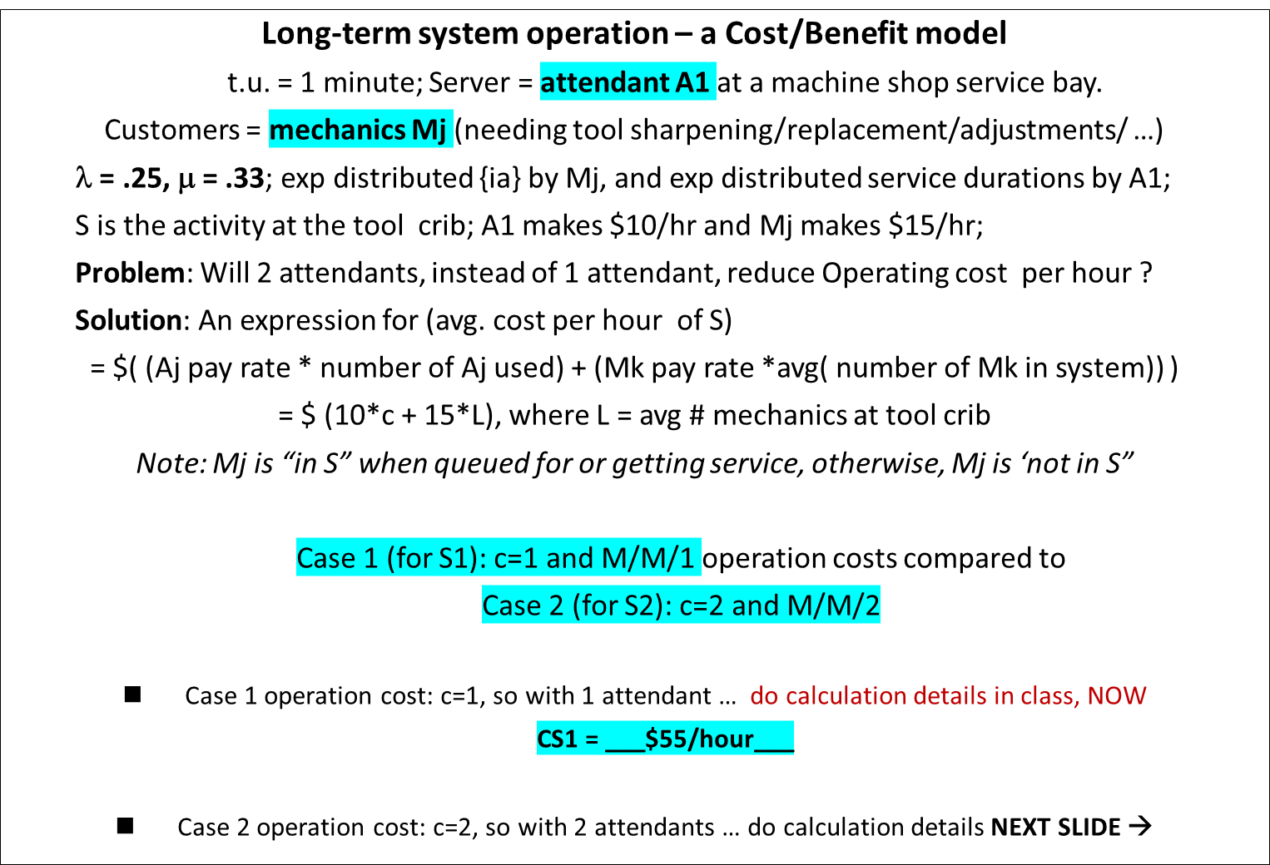
Tool crib Attendants in a machine shop - 1 of 2

Slide 14
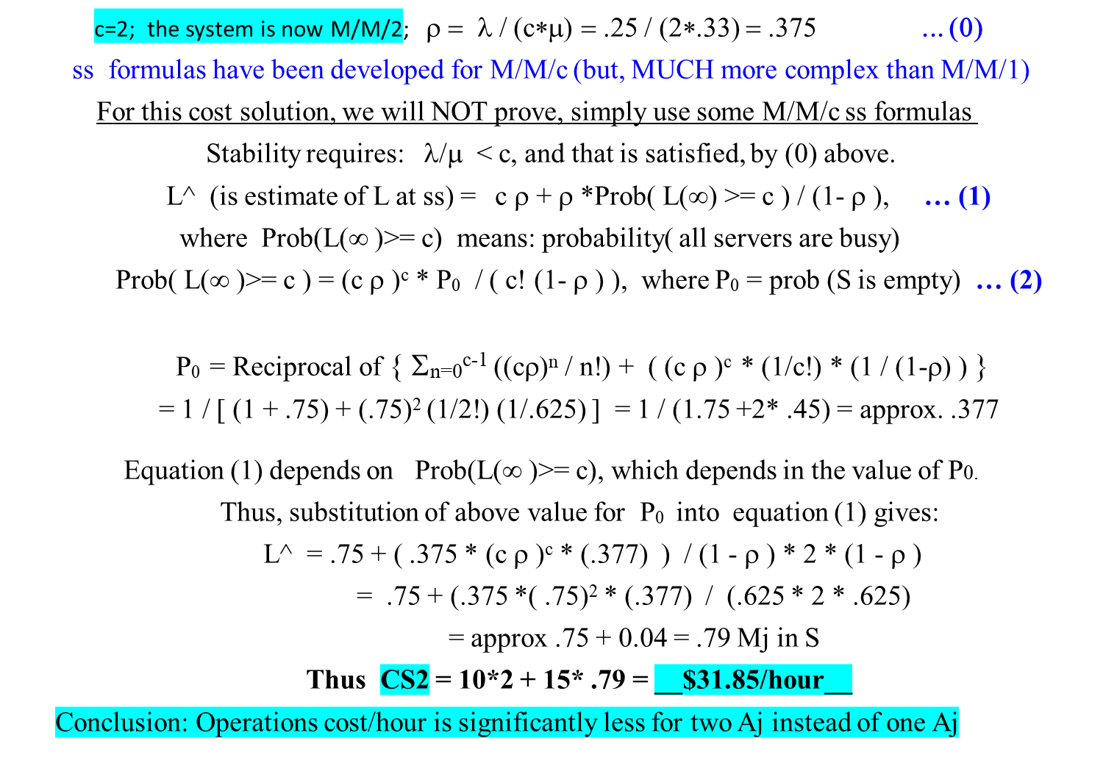
Tool crib Attendant System – 2 of 2

Slide 15
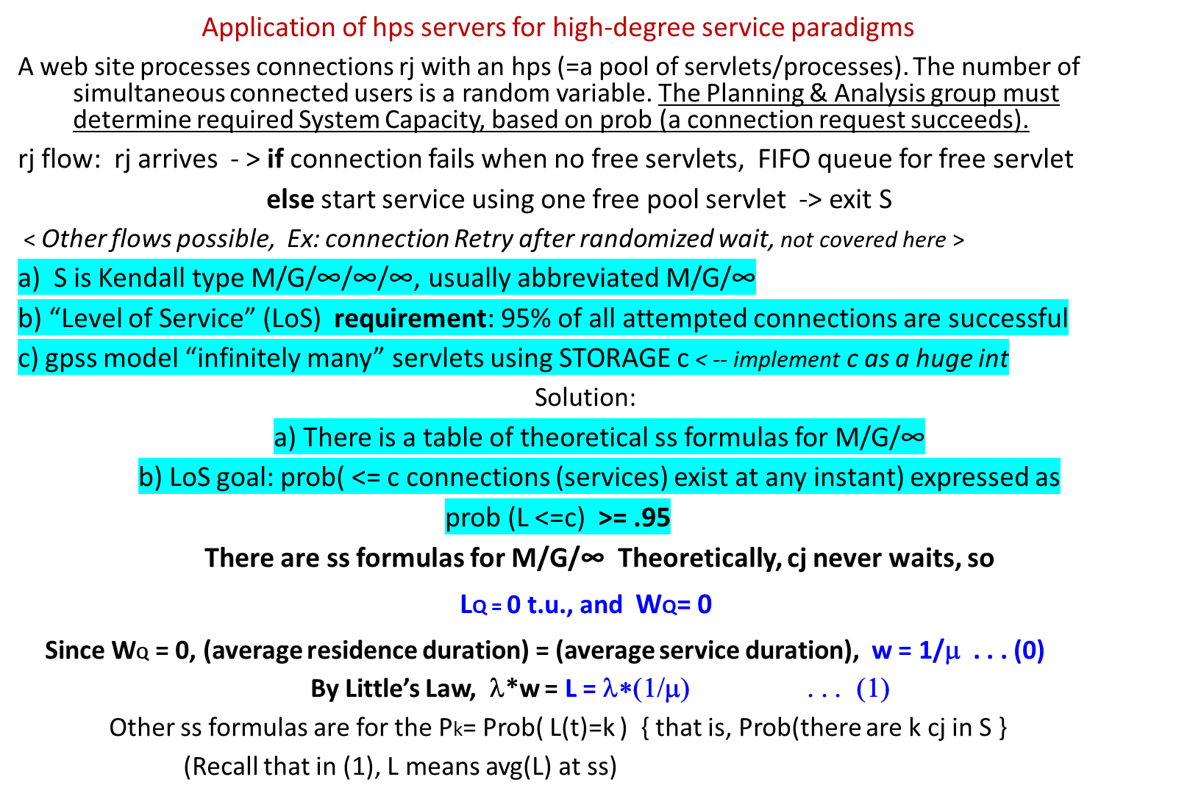
An M/G/infinity steady-state example

Slide 16
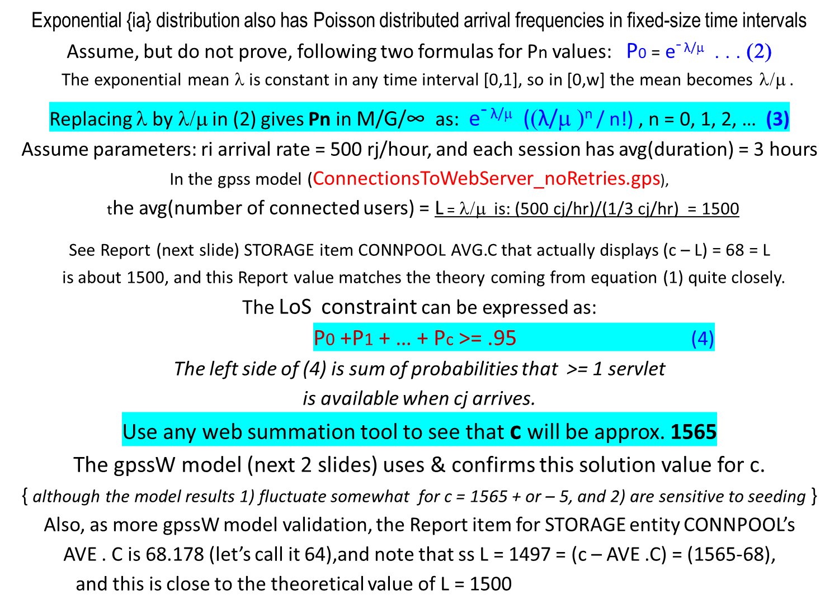
An M/G/infinity steady-state example

Slide 17
gpssW M/M/∞ model – Source code – 1 of 2
; The web site connections simulation - an M/M/infinity model connectionsToWebServer_noRetries.gps
; Arriving connection requests finding no free servers wait for free server; connection retries not implemented
; Simulated t.u. - 1 minute Model Runs: Start 1000000; Model termination when tc < -- 0
CLEAR
; Max number of concurrent connections (=ss theoretical value) to achieve required LoS = .95
connPool STORAGE 1565
RMULT 1294605 ; Seeding
max_tr EQU 1000000 ; Max tr processed (not used in this model)
ia_mean EQU 0.12 ; {ia} mean time
conn_mean EQU 180 ; Mean customer connect duration
INITIAL x$numOfWaits,0 ; Total num of requests that waited
INITIAL x$numOfConnections ; Total num of connections
INITIAL x$connWaitedPct,0 ; Percent of connections that waited
makePool generate 0,,0,1,1 ; This tr runs first, & only 1 time at incr prior vs. cj tr
enter connPool,1565 ; Configure pool of servlets/processes
terminate
conn_Start GENERATE (Exponential(1,0,ia_mean)) ; Connection requests
TEST E s$connPool,0,getConnection ; Branch if cj does not need to wait
SAVEVALUE numOfWaits+,1 ; Incr count of service waits
getConnection GATE SNE connPool ; Connect if a process is free, else wait
LEAVE connPool,1 ; Got a connection; start random-duration session
SAVEVALUE numOfConnections+,1 ; Incr successful connect count
ADVANCE (Exponential(1,0,conn_mean)) ; Session duration exp distributed
ENTER connPool,1 ; Finished work, break connection
savevalue connWaitedPct,(x$numOfWaits/x$numOfConnections) ; Upd. cj waited %
conn_Finish TERMINATE 1 ; Request/service finished

Slide 18
gpssW M/M/∞ model – Results – 2 of 2
Report results fragment
Monday, October 14, 2019 21:56:40
START TIME END TIME BLOCKS FACILITIES STORAGES
0.000 120235.407 13 0 1
LABEL LOC BLOCK TYPE ENTRY COUNT CURRENT COUNT RETRY
MAKEPOOL 1 GENERATE 1 0 0 < -- hps initialization transaction
2 ENTER 1 0 0
3 TERMINATE 1 0 0
CONN_START 4 GENERATE 1001516 0 0
5 TEST 1001516 0 0
6 SAVEVALUE 58035 0 0
GETCONNECTION 7 GATE 1001516 0 0
8 LEAVE 1001516 0 0
9 SAVEVALUE 1001516 0 0
10 ADVANCE 1001516 1516 0 < -- Current L value when model terminated
11 ENTER 1000000 0 0
12 SAVEVALUE 1000000 0 0
CONN_FINISH 13 TERMINATE 1000000 0 0
STORAGE CAP. REM. MIN. MAX. ENTRIES AVL. AVE.C. UTIL. RETRY DELAY
CONNPOOL 1565 1516 0 1565 1001565 1 68.178 0.044 0 0
SAVEVALUE RETRY VALUE
NUMOFWAITS 0 58035.000
NUMOFCONNECTIONS 0 1001517.000
CONNWAITEDPCT 0 0.058 < -- % of connection requests that failed (and then waited)

Slide 19
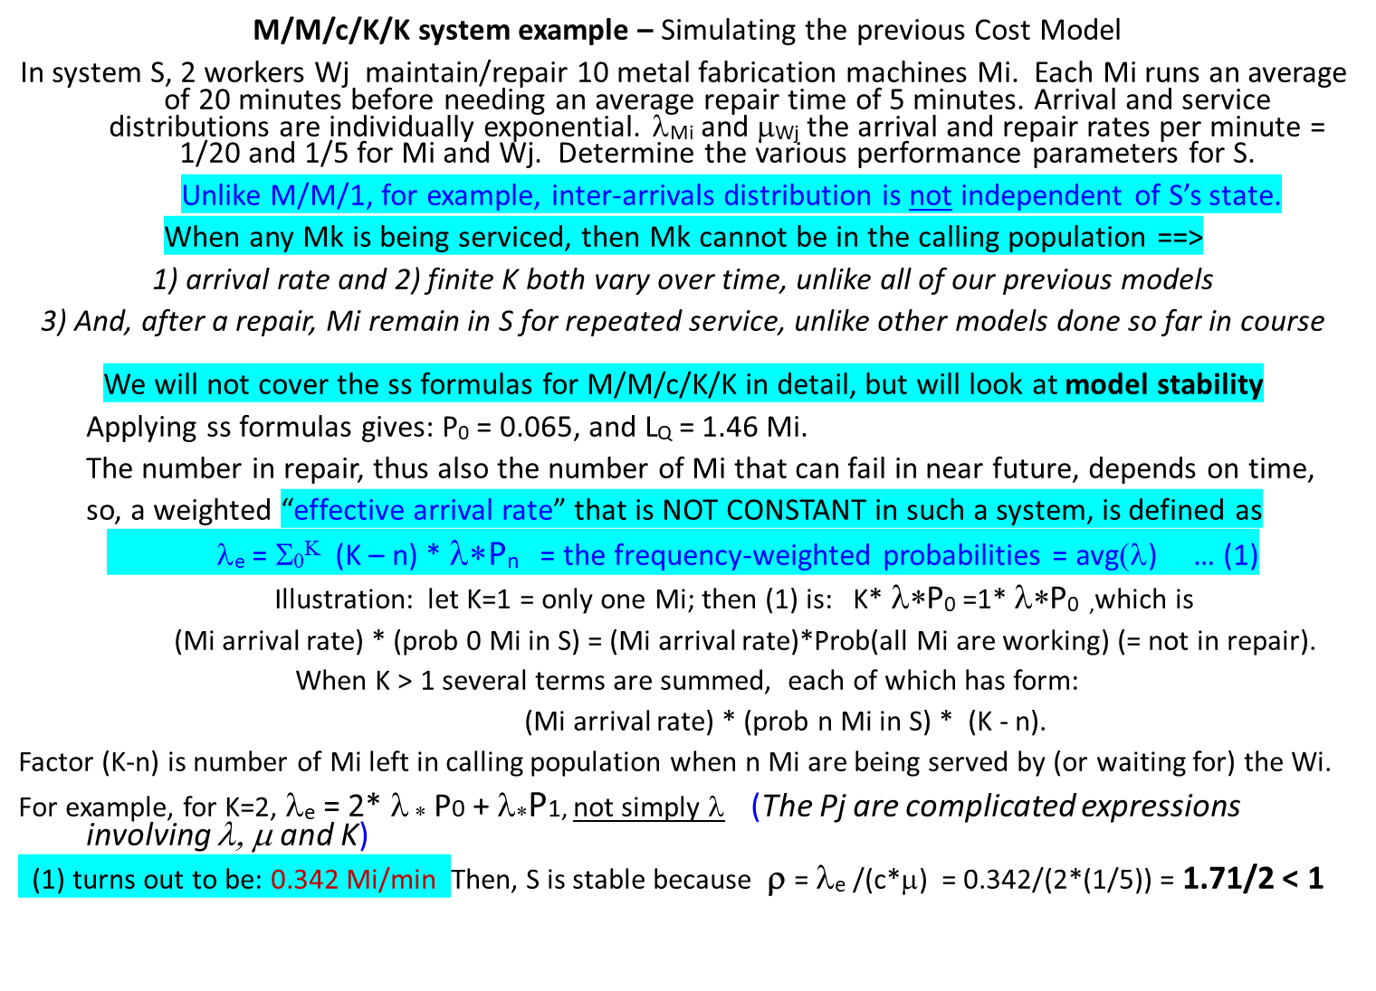
M/M/c steady-state examples, cont’d

Slide 20
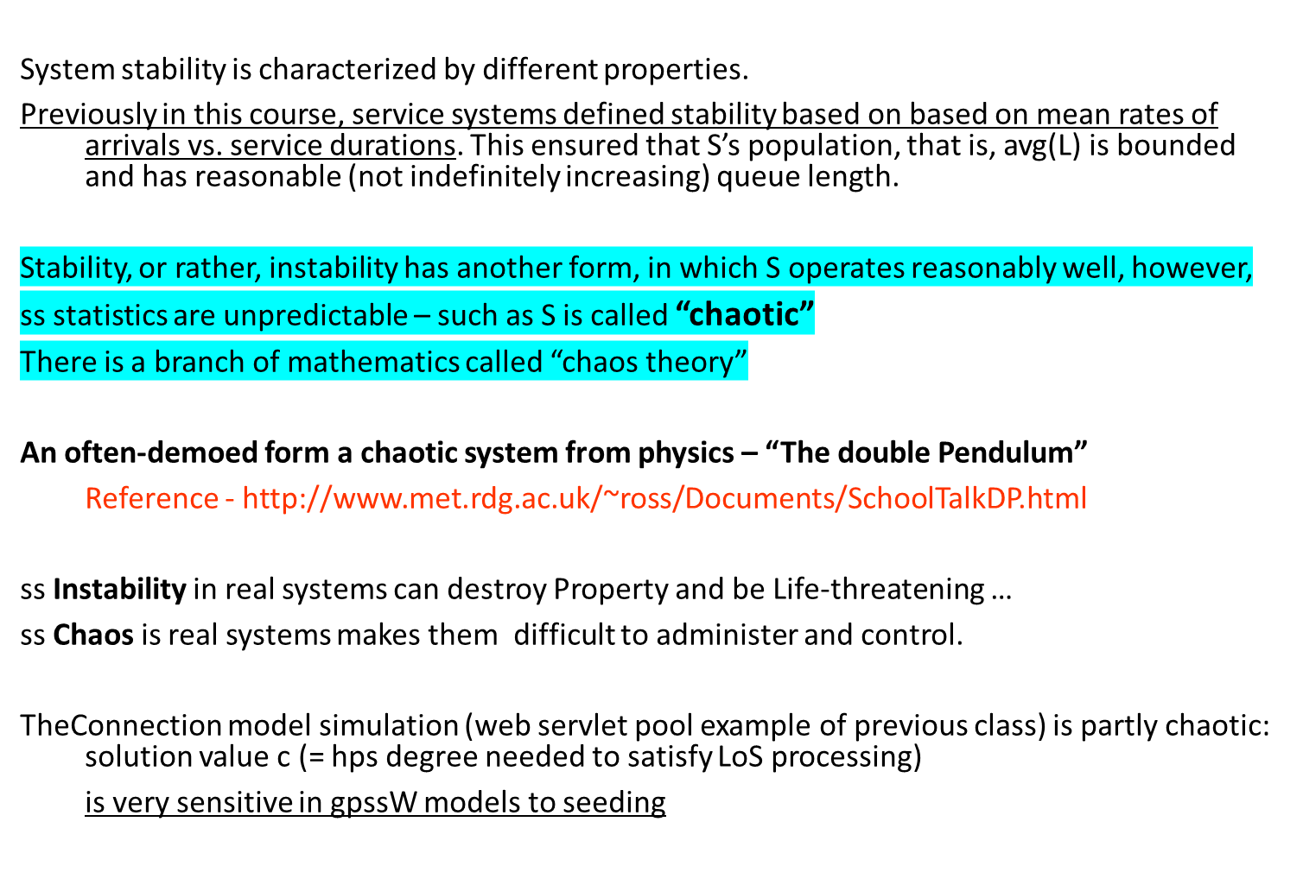
More on Chaotic systems

Slide 21
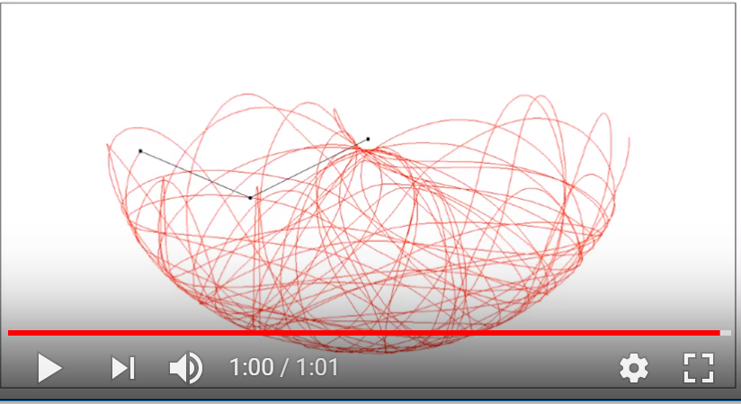
Double pendulum – locus of motion trace of end of lower arm
The double pendulum is VERY sensitive to initial conditions.
Initial conditions are the way in which a system is started). The initial conditions (IC) for the double pendulum are the starting angles of each arm, and their initial speeds. With even VERY SLIGHTLY different ICs, a quite different trace will result compared to the one below.

Slide 22
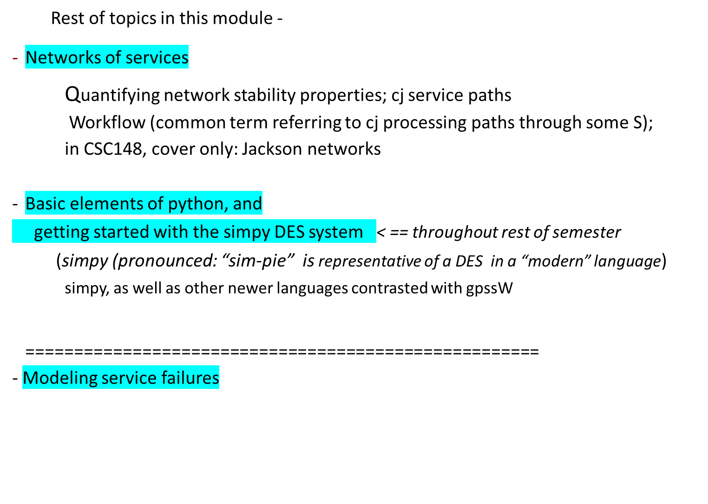
Start of – more complex service systems

Slide 23
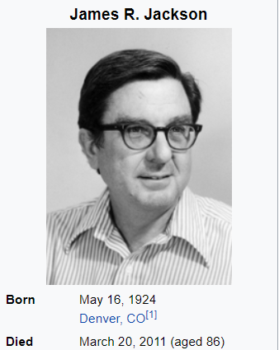
Networks of servers and queues
A “big box” store: BestBuy/HomeDepot/ etc.
features several service centers, and such an S can be abstractly viewed as a network of service nodes. cj enters such a system and optionally visits (and queues for service) at some servers while bypassing some others.
There are traffic flow assumptions about the characteristics of such a connected set of “service nodes”. The assumptions involve the path taken by the ci as the ci progress among the service nodes.
In queueing theory, a discipline within the
mathematical theory of probability,
a Jackson network (sometimes Jacksonian network^{[1]})
is a class of queueing network where the equilibrium distribution
is particularly simple to compute as the network has a
product-form solution. It was the first significant development
in the theory of networks of queues
ddddd

Slide 24
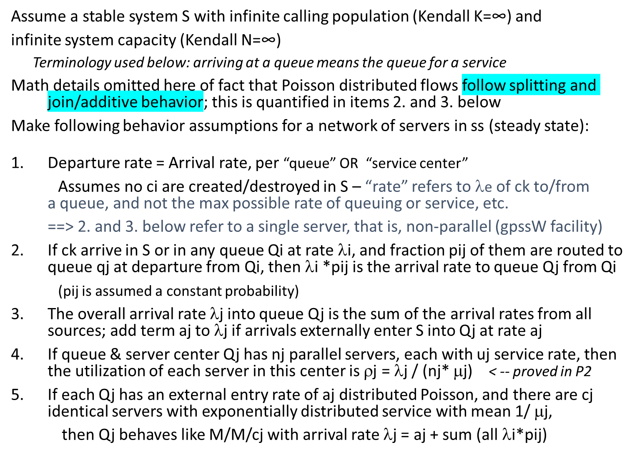
Networks of servers and queues – Jackson network assumptions

Slide 25
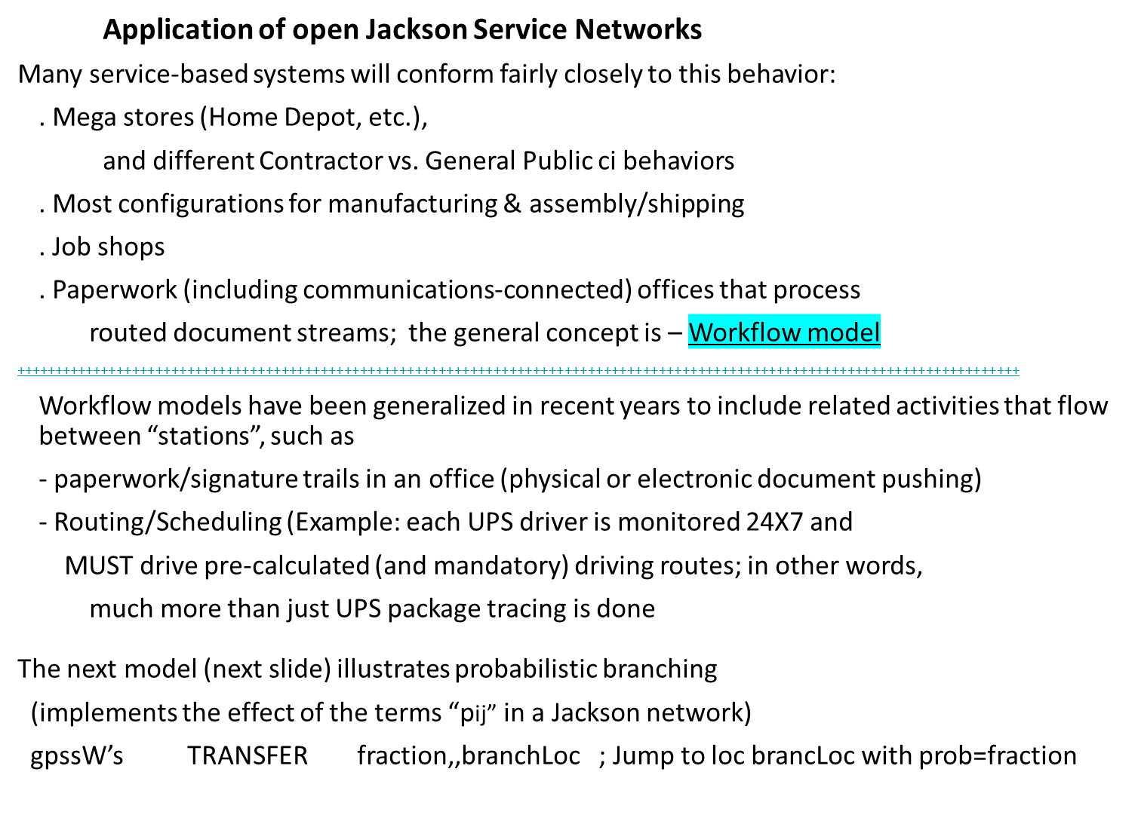
Networks of servers and queues – applications examples

Slide 26
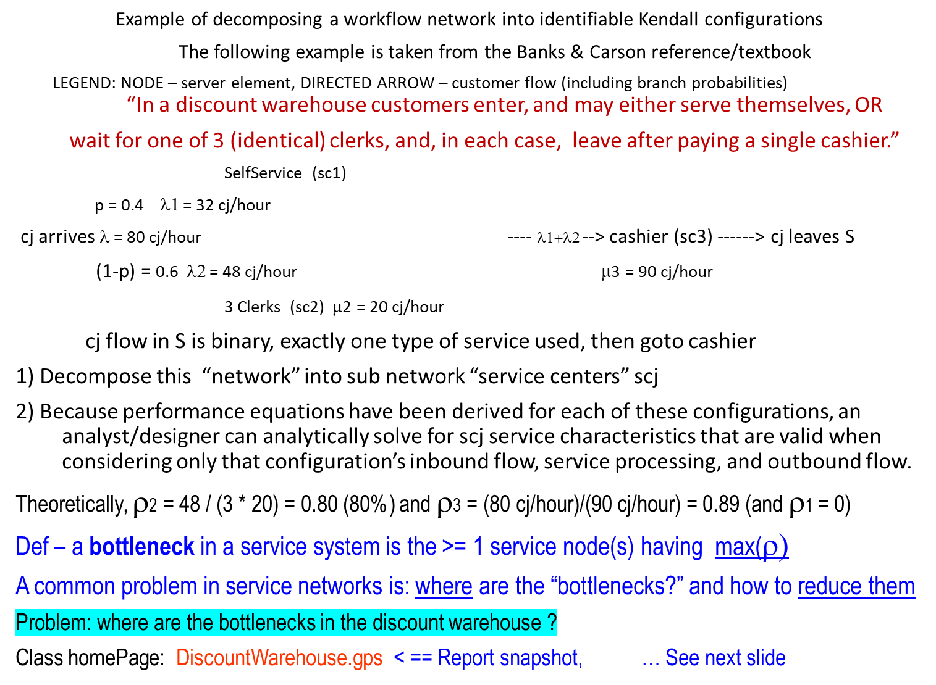
A decomposition of a system of servers

Slide 27
DiscountWarehouse.gpr Model results for 5000 cj (2 ½ days of 24X7 continuous operation)
FACILITY ENTRIES UTIL. AVE. TIME AVAIL. OWNER PEND INTER RETRY DELAY
CASHIER 5001 0.894 0.664 1 4976 0 0 0 10 <= cashier stats check
QUEUE MAX CONT. ENTRY ENTRY(0) AVE.CONT. AVE.TIME AVE.(-0) RETRY
CLERKS_RESIDENCE_TIME 41 1 3016 0 6.470 7.966 7.966 0
SELF_RESIDENCE_TIME 6 1 1997 0 0.519 0.965 0.965 0
CLERKS_SERVICE_TIME 3 1 3016 0 2.528 3.112 3.112 0 <= close, for 5000 cj
SELF_SERVICE_TIME 6 1 1997 0 0.519 0.965 0.965 0 <= checks
CASHIER_RESIDENCE_TIME 49 11 5011 0 9.403 6.969 6.969 0
CASHIER_SERVICE_TIME 1 0 5000 0 0.894 0.664 0.664 0 <= checks
STORAGE CAP. REM. MIN. MAX. ENTRIES AVL. AVE.C. UTIL. RETRY DELAY
CLERKS 3 1 0 3 3018 1 0.471 0.157 0 0
SELFSERVICE 10000 1 0 10000 11996 1 9996.788 1.000 0 0
gpssW is not well-suited for modeling large, complex networks of queues, especially modeling complex service paths through such networks.
CLERKS utilization: approx. 0.84
SELFSERVICE utilization: 0

Slide 28
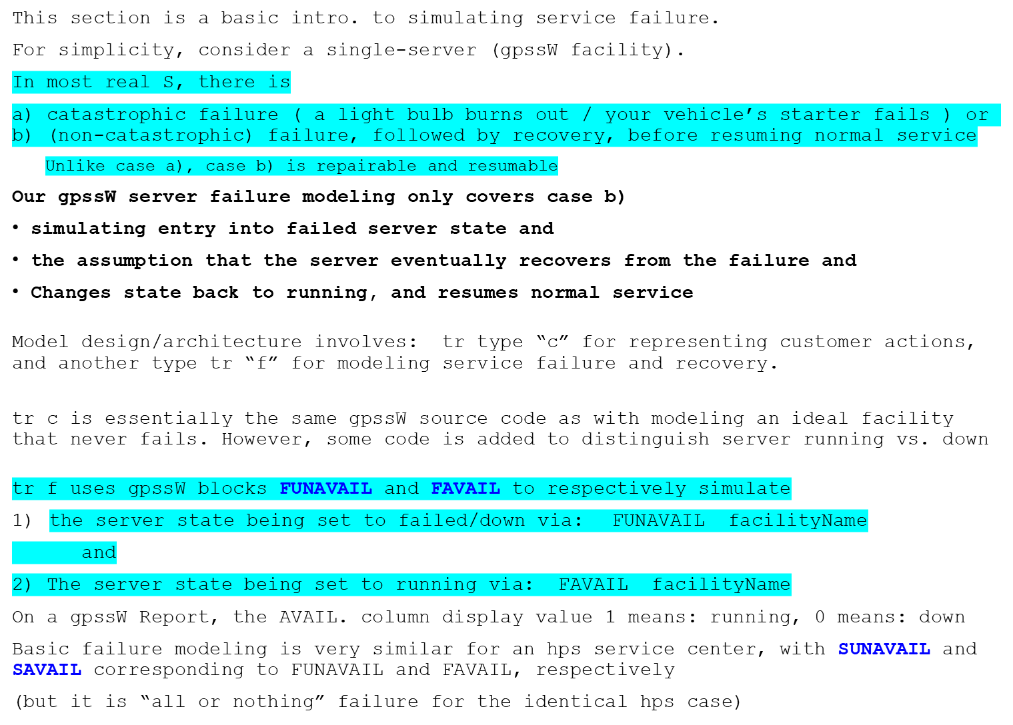
Introduction to service failure modeling – 1 of 3

Slide 29
Introduction to service failure modeling – 2 of 3
For introductory gpssW failure models, fortunately, (making the coding a lot easier)
the gpssW default for recovery from non-catastrophic) failure is:
Jobs jk / Customers cj continue to arrive into S, and are simply queued for processing during recovery from failure (no user code needed to track/trace the cj)
If a cj happened to be executing on the server at the instant of failure,
such a cj is automatically completed as part of recovery.
This is a very significant simplification, that is also true if simulating failure of an hps.
In real large-scale systems S (such as an OS or a DBMS), recovery involves 3 kinds of processing:
1. REDO
2. UNDO
3. UNDO followed by REDO (means: remove incomplete changes of a process, and then
REDO (that is, re-execute) the process from the beginning
All such recovery processing is done with automatically executing software, with no human intervention = = > automatic S restart with a minimal loss of info/data
{ This is not an OS, or DBMS, or networking class, so none of the specifics of UNDO/REDO will be covered in this course }
The next slide is a Demo trace of a very simplified Kendall Constant/Constant/1
Model – it shows the processing of arriving cj for one failure event = = >

Slide 30
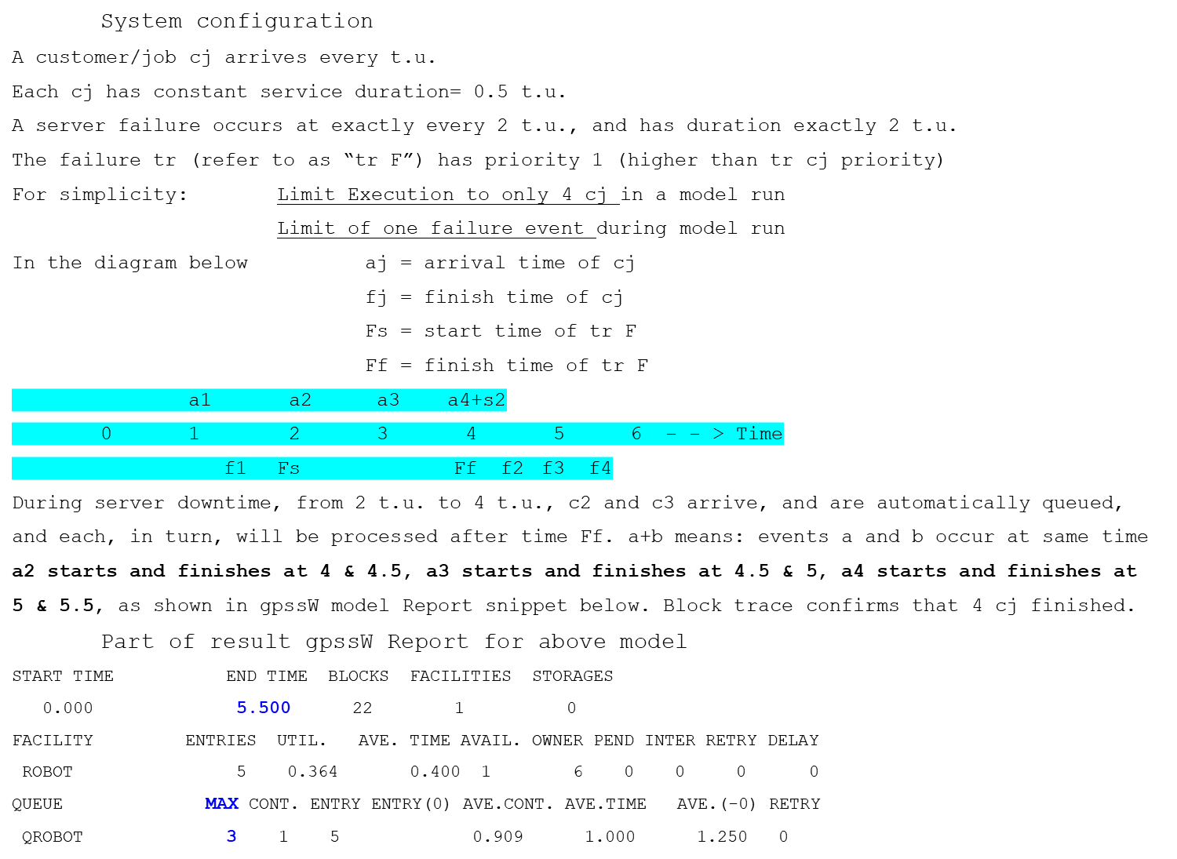
Introduction to service failure modeling – 3 of 3

Slide 31
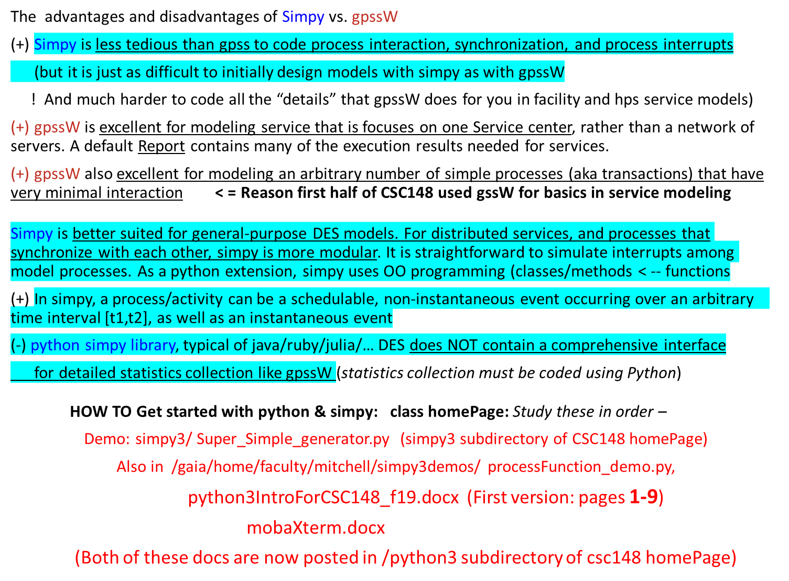
Getting started with DES in Simpy

